Slide 1
The Drastic Evolution of SDN and Where it is Going
CSCI 8211 Yiwen Wan

Slide 2
Agenda
Motivation
SDN in a Nutshell
Facebook’s “Wedge” and “FBOSS”
Google’s Espresso

Slide 3
Motivation
New to me
The use of SDN is growing exponentially in industry
Many open sources to look at

Slide 4
SDN in a Nutshell
As we discussed in class, SDN has the following key features:
Separation of the control plane from the data plane
Logically centralized controller and view of the network
Open interfaces between the devices in the control plane (controller) and those in the data plane
Programmability of the network by external applications

Slide 5
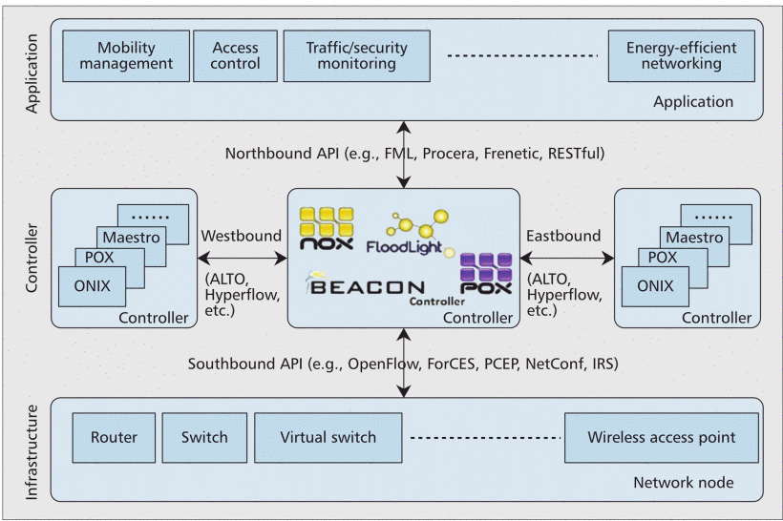
SDN in a Nutshell (cont.)
SDN functional architecture illustrating the infrastructure, control, and application elements of which the network is comprised
“Are we ready for SDN? Implementation challenges for software-defined networks”,2013

Slide 6
Facebook’s “Wedge” and “FBOSS”
“Wedge” and “FBOSS”:
Facebook Open Switching System (FBOSS): Facebook's software stack for controlling and managing network switches
Wedge: Facebook’s top-of-rack network switch

Slide 7
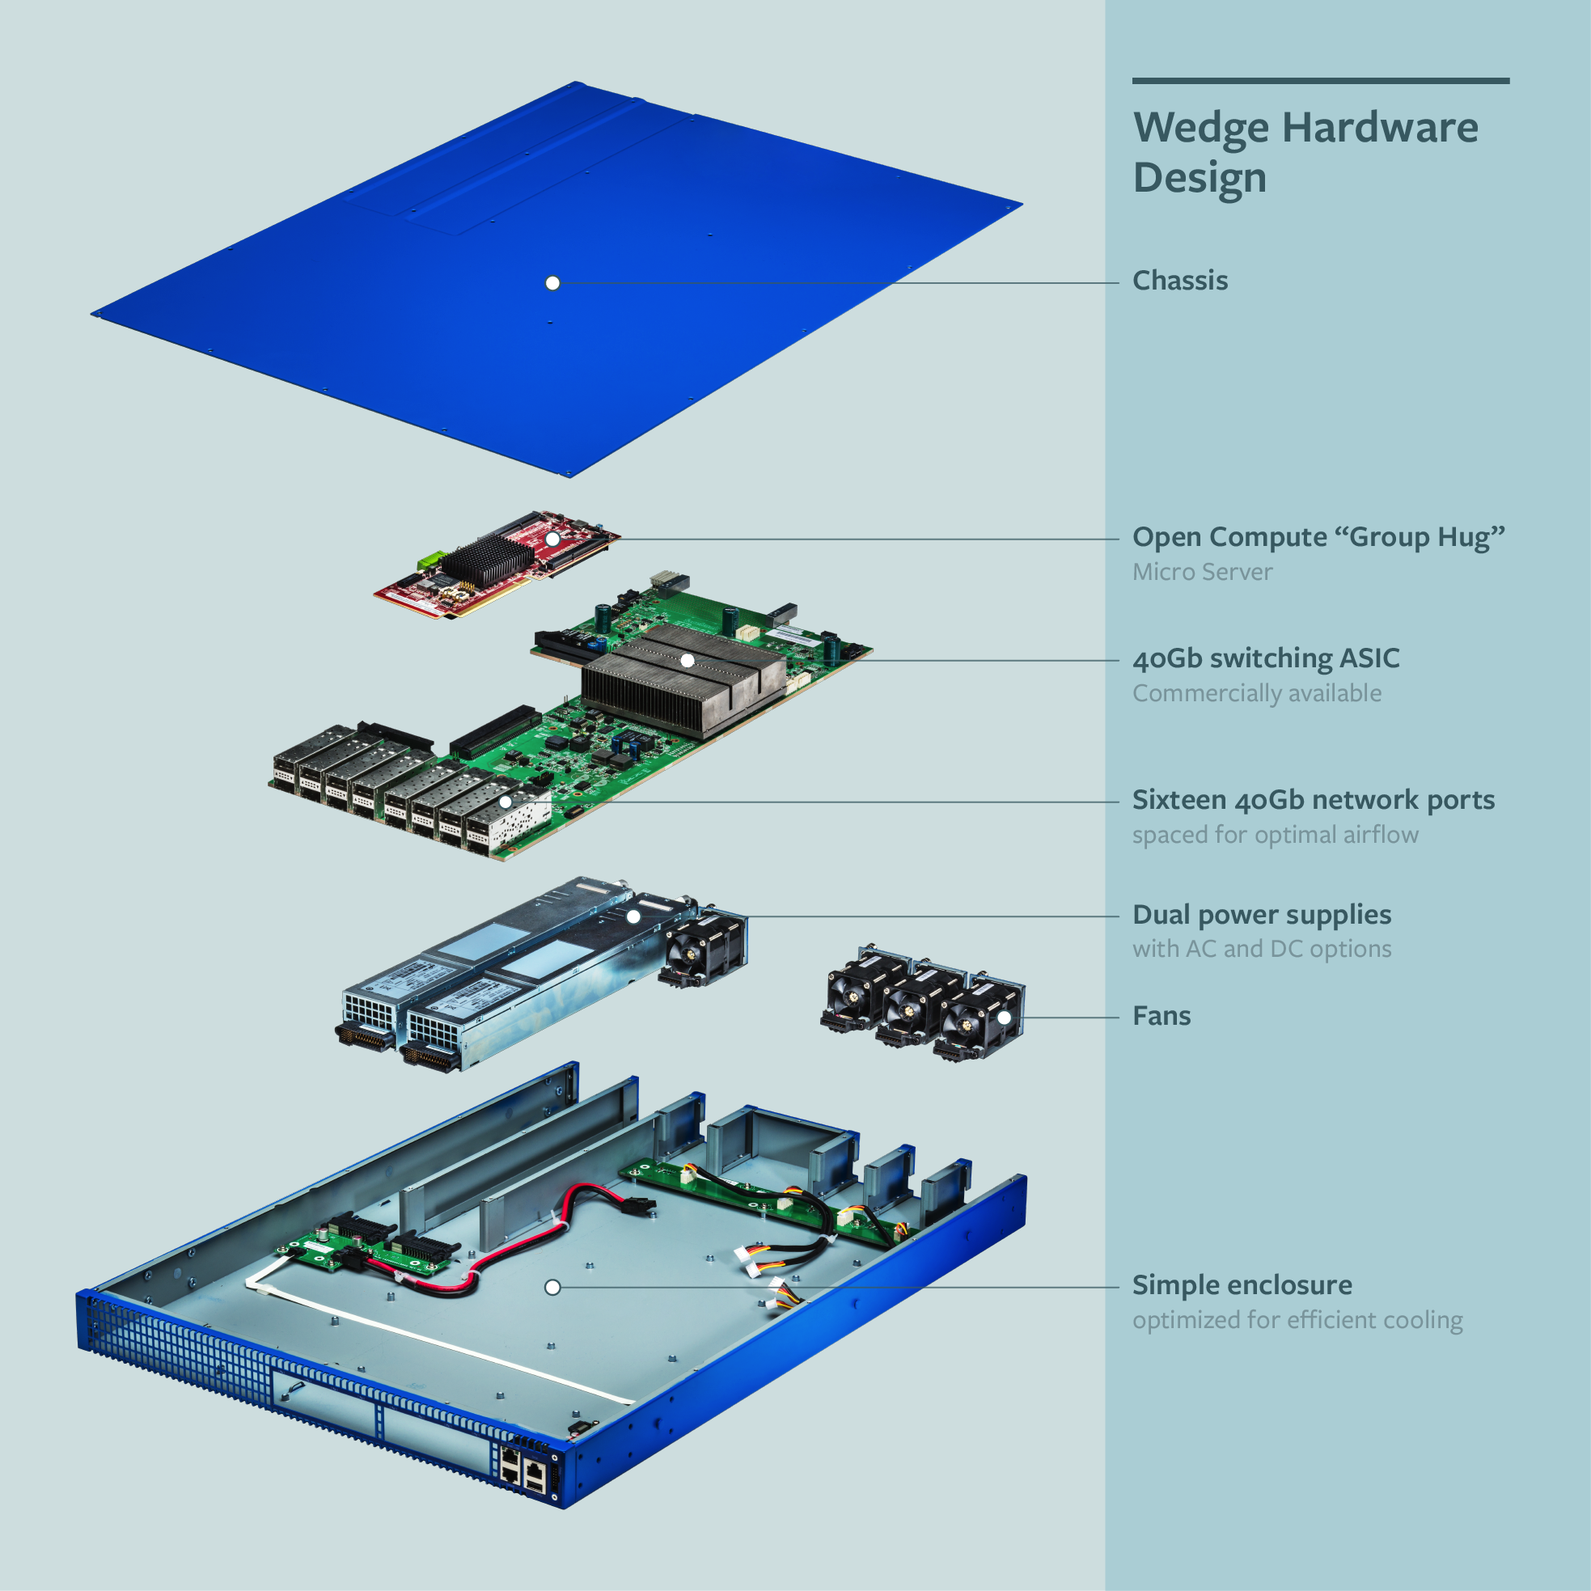
“Wedge”
“Introducing “Wedge” and “FBOSS,” the next steps toward a disaggregated network”, 2014

Slide 8
“FBOSS”
The FBOSS agent includes support for:
Programming various tables within the Broadcom ASIC, such as L2, L3, and VLAN tables.
Handling low-level control packets for host and neighbor learning (ARP, IPv6 NDP, DHCPv4/v6 relay, LLDP).
Packet parsing/construction of ICMP/UDP packets.

Slide 9
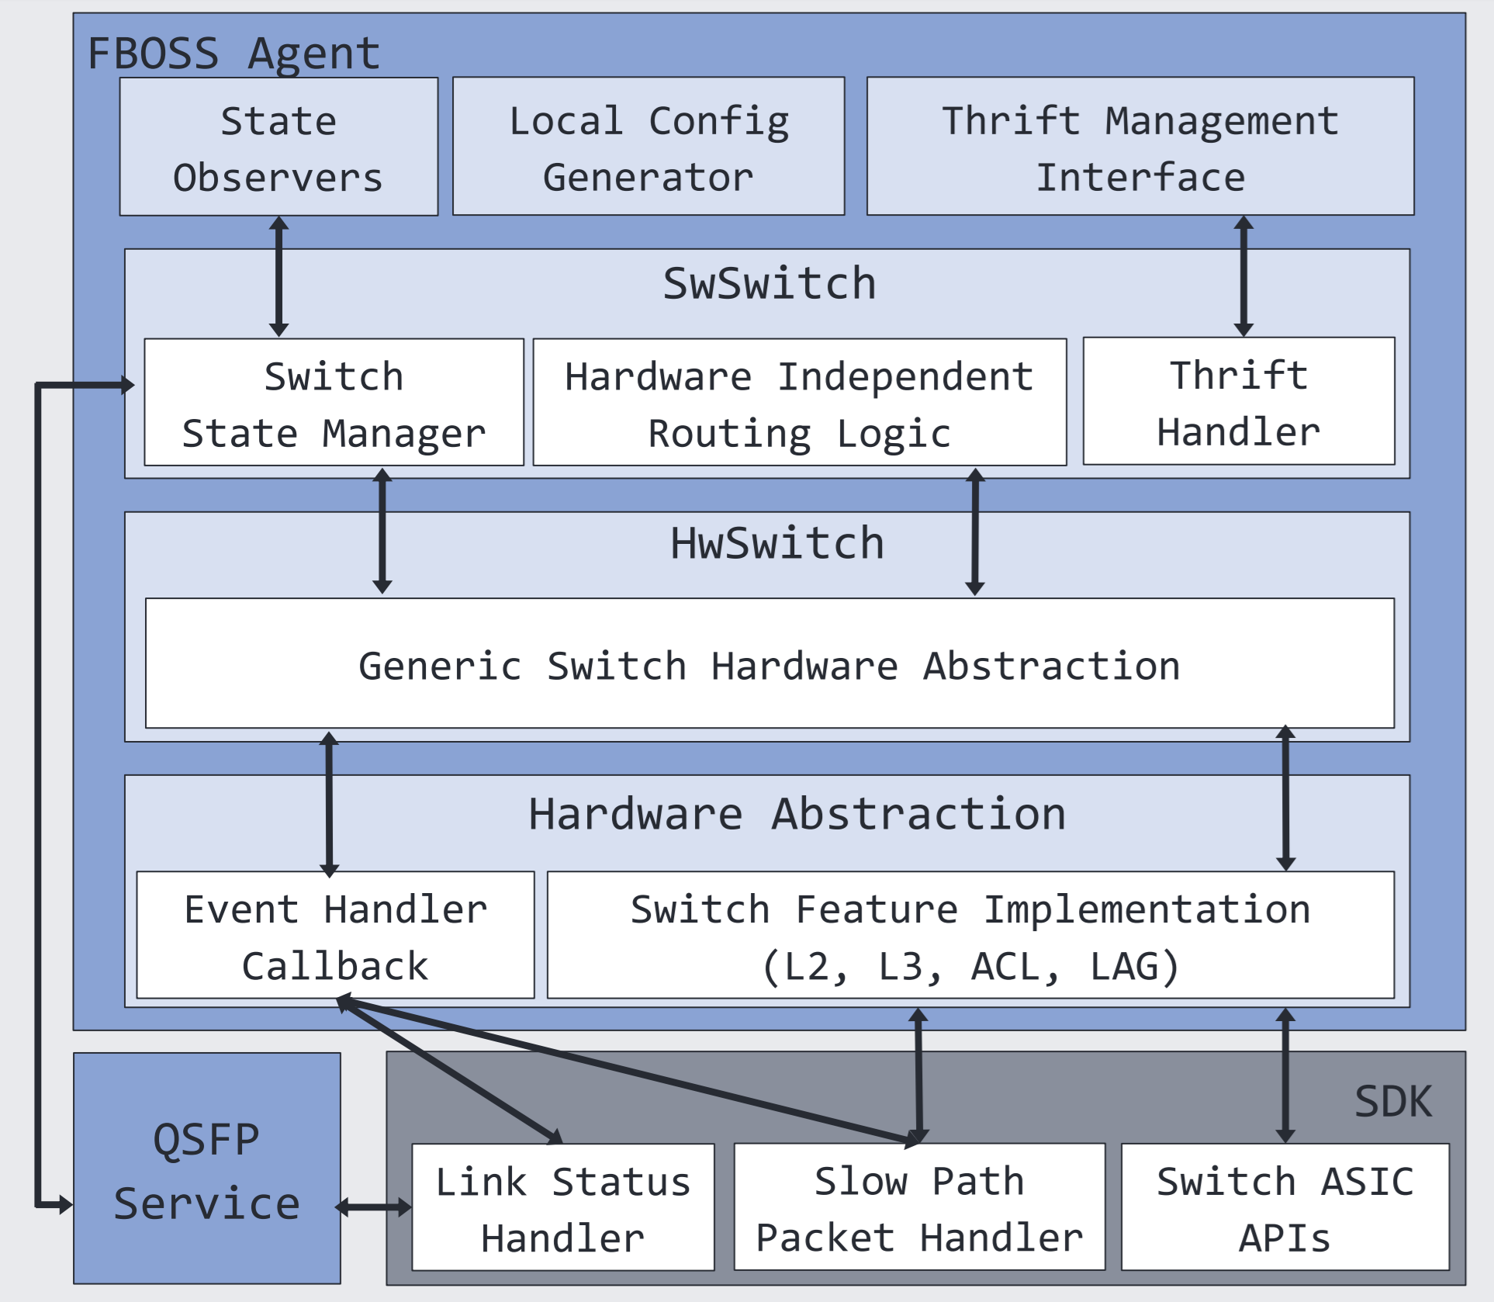
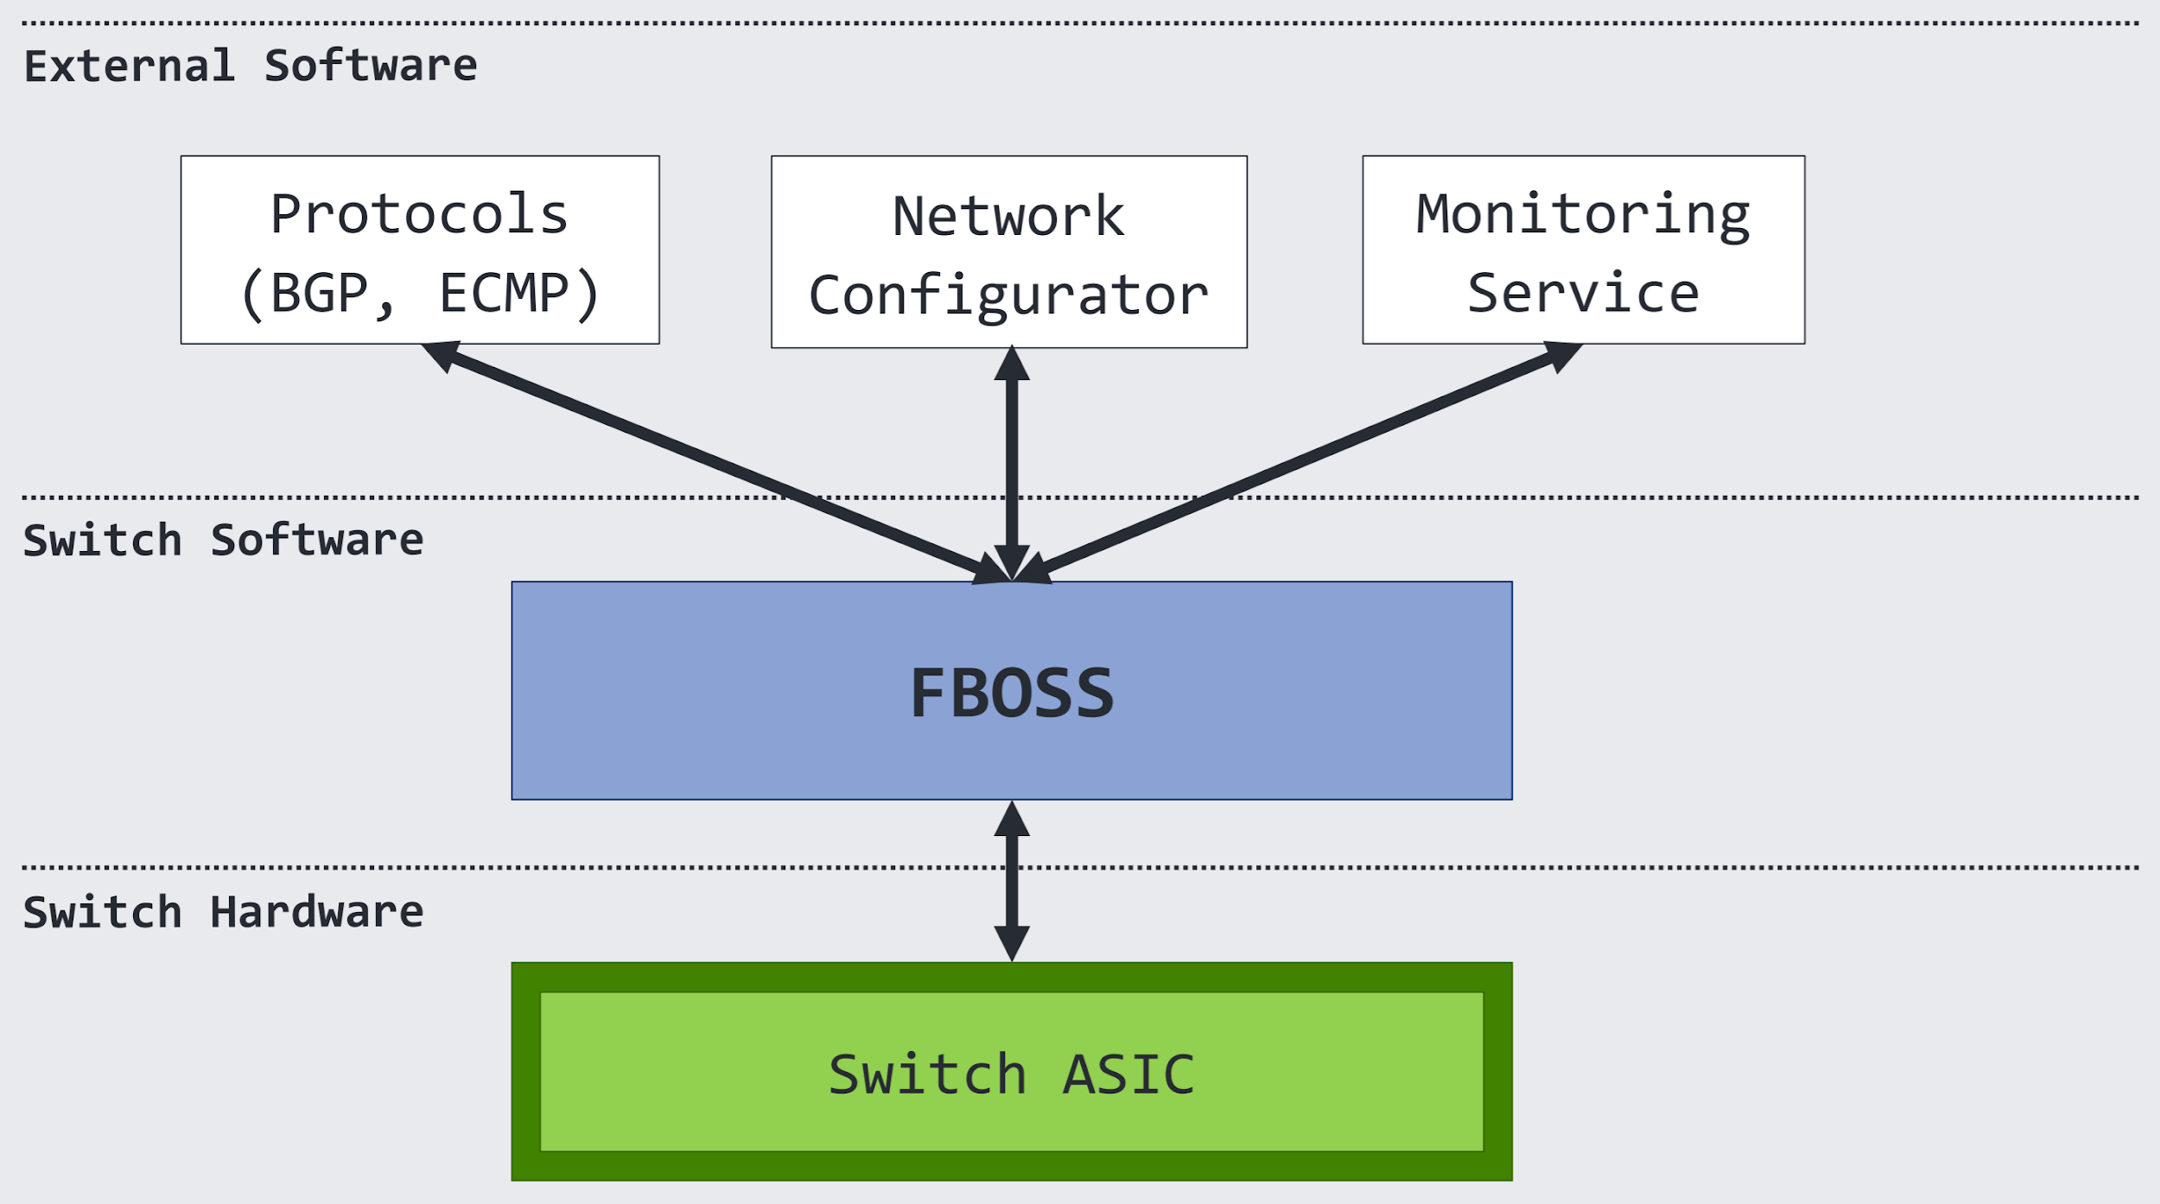
FBOSS Architecture
“FBOSS: Building Switch Software at Scale”,2014

Slide 10
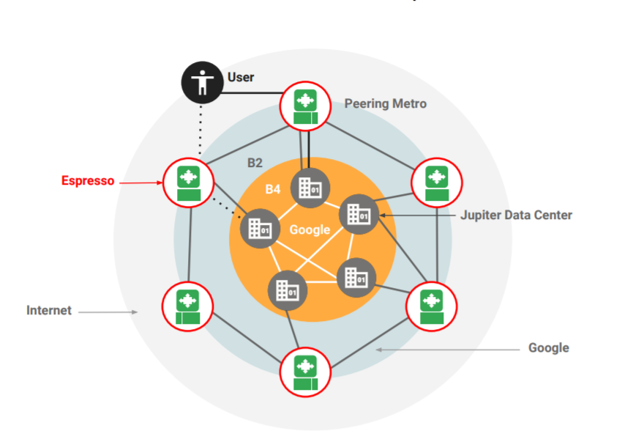
Google’s Espresso
Espresso: SDN-based peering edge routing infrastructure
Overview of Google WANs:
“Taking the Edge off with Espresso: Scale, Reliability and Programmability for Global Internet Peering”, 2017

Slide 11
Google’s Three SDN Pillars
Jupiter
B4 WAN Interconnect
Andromeda

Slide 12
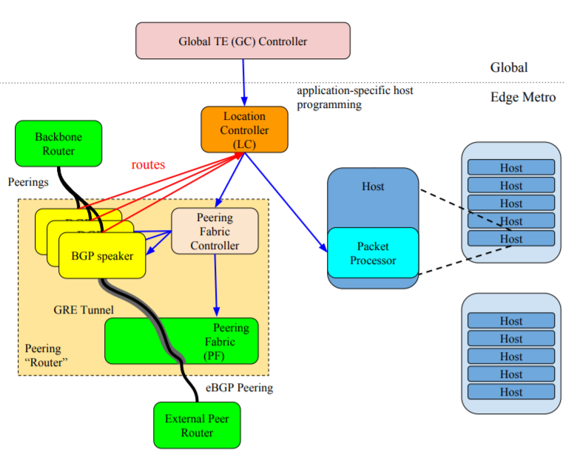
Espresso Control Plane Overview
“Taking the Edge off with Espresso: Scale, Reliability and Programmability for Global Internet Peering”, 2017

Slide 13
“By now, SDN has advanced beyond its adolescence and early euphoria and has settled into early adulthood as something of a known commodity. It is not so much the next big thing on the networking horizon as much as it is a reality and inevitability for enterprises and service providers worldwide, even for those who have yet to embrace it.”
-- Mehra and Casemore 2017

Slide 14
Thank you!

